Slide 1
Managing the sustainability of events and festivals – Towards an international classification system
ZEN Project
Andres Coca-Stefaniak
Ian Bathgate

Slide 2
Zero-impact Cultural Heritage Event Network (ZEN)
Notes:
1.4 million Euro budget project co-financed (75%) by the European Commission’s INTERREG IVC programme
One of a handful of EU-funded projects that UEL currently have
UEL IS THE LEAD RESEARCH PARTNER OF COMPONENT 3 THE AIM OF WHICH IS TO
‘DEVOTED TO THE EXCHANGE OF GOOD PRACTICES AND EXPERIENCES AMONGST PARTNERS.’

Slide 3
ZEN project’s approach
Transnationality (IT, UK, LT, LV, GR, RO, BG, SL, NL, ESP) and practice-based research
Notes:
Transnationality is at the core of the INTERREG IVC programme but also the root of innovation in the ZEN project
12 partners from 10 countries
Partners include universities (e.g. Erasmus University Rotterdam), regional development agencies, county councils, local authorities and business incubators
THIS IS AN EXAMPLE OF PRACTICE BASED RESEARCH.
AS MENTIONED UEL IS LEAD RESEARCH PARTNER
THE RESEARCH BEING DRIVEN BY THE FOLLOWING GOALS
-INNOVATION
-A PRACTCE BASED FOCUS AND ROBUSTNESS
TRANSNATIONALITY
LINKS TO POLICY.
THE OUTPUTS ARE
1/ REPORT ON PARTNERS EXPERIENCES (INVOLVES REPORT ON EVENT AND AUDIT OF EXISITNG EVENT EVALUATION METHODOLOGIES IN EACH COUNTRY
2/ BEST PRACTICE REPORT – SERIES OF CASE STUDIES
3/ POSITIONING PAPER ON THE REDUCTION OF EVENT’S ENVIRONMENTAL IMPACT. – COMPARATIVE STUDY AND DEVELOPMENT OF A PAN EURPOEAN EVENTS TYPOLOGY.

Slide 4
ZEN project’s aims
European innovation in the development, management and evaluation of sustainable cultural events in historic town centres
Can an event have zero impact on the environment?
Notes:
The only event with a zero impact is a cancelled event
However, there are ways to reduce the negative impacts of events and festivals on the environment. Practice on how to do this varies considerably across Europe.
Image from Hay Festival of Literature and the Arts (Powys, Wales) DEVELOP WHAT HAY DOES AND THEN REFER TO PERUGIA JAZZ AND CHOCOLATE FESTIVAL DOWN TO LATVIAN FOLK ARTS FESTIVAL.
There is also a perfectly good market-led business case for reducing the negative impacts of events, as the next slide shows

Slide 5
2012 pan-Euopean survey festival goers (Moore, 2013)
49.8% would pay higher ticket price to make festival greener
43% had changed behaviour as a result of festival’s green initiative(s)
Waste, traffic and noise seen as key negative impacts
Responsibility for impact – festival organiser (but also festival goers – 79%)
Sample size: 2,281
Buckinghamshire New University
Notes:
This study was carried out with respondents in four EU countries, including the UK
Similar surveys in Italy have also showed a willingness by festival goers to pay more for tickets if the festival can prove its green credentials
49.8% festival goers agreed they would pay higher ticket price to make festival greener
Festivals as opportunities for social marketing: 43% had changed behaviour as a result of festival’s green initiative(s)
Although the main negative impact of international festivals is the air travel of visitors to get there, this is not something festivals can influence easily, so emphasis here is on more local negative impacts
Festival goers beginning to internalise responsibility for impact on the environment and no longer blaming organisers -> Responsibility for impact – festival organiser (but also festival goers – 79%)

Slide 6
Why evaluate impacts of events?
City image (Richards and Wilson, 2004)
Justify public spending (Faulkner et al, 2003)
Host communities getting best possible benefits (Chalip, 2004; O’Brien 2006)
Lasting legacy for communities (Ritchie, 2000)
Notes:
Festival and events are often closely associated with the image and brand of places (e.g. hallmark events) and can have a pivotal role in changing resident and visitor perceptions about places
Research on event evaluation in the past has focused too much on economic impacts (as will be shown later in this presentation) and much of the justification for public funding of festivals has focused on this aspect
Increasingly, a “localism” effect is beginning to permeate event evaluation research in terms of investigating the benefits of festivals for local communities and their wider legacy at local level. The London 2012 Olympic and Paralympics Games were a good example of this.
SEE FEEDBACK FROM NEWHAM COUNCIL

Slide 7
Example of legacy-focused evaluation framework
Sport and physical activity
2012 Olympic and Paralympic impacts
Culture and community
Economic
Climate change
Environmental
Air
Noise and light
Land
Ecosystems
Water
Waste
DCMS (2012; p. 22)
Notes:
Example of legacy-focused event monitoring and evaluation framework from London 2012 Olympics. This work and associated indicators were led by UEL’s researchers at the Sustainability Research Institute .
MEGA AND PEDERSEN (1998) PROVIDE AN ANCHOR EVALUATION FRAMEWORK BASED ON 3 COMPONENTS ON HUMAN ACIVITIES, (2 FLOWS FROM (BURDEN) AND BACK (RESOURCES)PHYSICAL AND SOCIO-ECONOMIC ENVIRONMENT (2 FLOWS FROM INFORMATION AND BACK RESPONSES).AND AGENTS (HOUSEHOLDS, ENTREPRISES,ASSOCIATIONS,ADMINISTRATION AND COMUNITIES).

Slide 8
From monitoring to legacy and … beyond?
Outcome sub area | Objective | Source | Output indicators | Outcome indicators
Noise and light | Deliver a sustainable Games and develop sustainable communities | Mayor of London’s Five Legacy Commitments | Noise levels Light levels | Impact on residents, visitors and businesses measured through surveys
Monitoring
Legacy
DCMS (2012; p. 35)
Notes:
An extract from UEL’s report for the London 2012 Olympics shows evidence of a focus both on the more immediate monitoring elements of impact as well as the longer-term legacy elements of this mega-event.

Slide 9
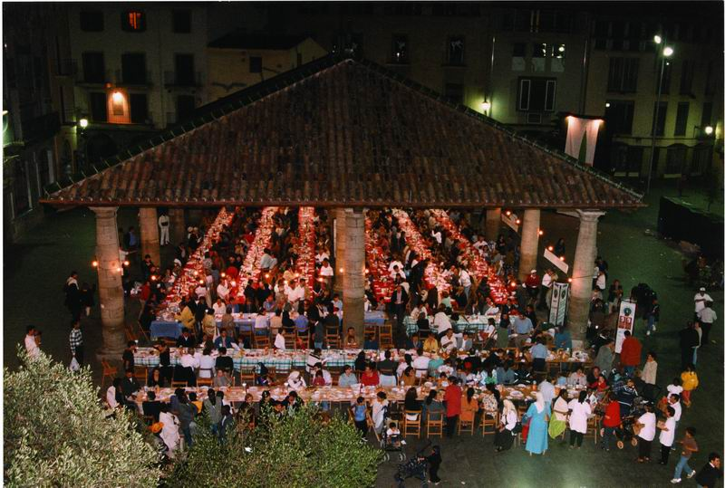
Notes:
So what happens if we get all the academic and practitioner communities under the same roof and consider events and festivals from a trans-disciplinary perspective rather than just a (traditional) tourism-based view?
MOVING BEYON THE ONE POINT EFFECT OF USING THE EVENT TO BOOST TOURISM BUT USING IT AS AN ONGOING SERIES OF EVENTS THAT AID IN PLACE BRANDING, CITY/PLACE MARKETING, EXPERIENTIAL MARKETING, CHANGE MANAGEMENT OF VISITOR BEHAVIOUR , SUSTAINABILITY AND ABOVE ALL LEGACY.

Slide 10
Events research and practice in the UK
Holistic understanding of events
2010 and beyond
Partnership management
Legacy
Resident attitudes
2000
Community interaction
Culture
Environmental impact
Social (local) impact
Mid 1990s
Urban renewal
Segmentation-led promotion
Place experience marketing
Destination image
Early 1990s
Urban tourism
Rural festivals
Hallmark events
1980s
Mega events
Economic impact
Coca-Stefaniak (2012) - on-going research
Notes:
One of the issues that may emerge is research trends over time!
This diagram (still research in progress) shows that although economic development imperatives dominated festivals and events from their outset (certainly in terms of impact evaluation), other disciplines of knowledge and strategic priorities (e.g. urban regeneration, public-private partnership working, social innovation, etc) have started to influence the way events and festivals are planned and delivered
STILL HAVE TO CHANGE THE MINDSET THOUGH AS ILLUSTRATED NEXT SLIDE.

Slide 11
Review of event management academic papers in “Festival Management and Event Tourism” (adapted from Getz, 2002)
Economic impact (26 articles)
Corporate sponsorship and marketing (14 articles)
Marketing and segmentation (11 articles)
Other management issues (9 articles)
Visitor and participant motives (7 articles)
Education, training, accreditation, research (7 articles)
Politics, policy and planning (4 articles)
Urban renewal (2 articles)
Law (1 article)
Arts and culture (1 article)
Notes:
… but economic impact still dominates with environmental impact as the ‘new kind on the block’ in research terms, as this ranking of articles published in the “Festival Management and Event Tourism” journal (today “Events Management” journal) shows

Slide 12
Early ZEN project research findings
Notes:
Case study-based research on this project is still on-going but here are some early results

Slide 13
Event environmental stewardship as promotion element (IT)
Transition from spontaneity to visitor-focused event planning (BG)
Events closely linked to local and regional branding campaigns (LV)
Notes:
In Italy, evidence of event stewardship by event organisers is being used (successfully) as added value promotion of the event
Issues of tourism commoditisation and loss of authenticity of event experiences are affecting some countries like Bulgaria, where upgrading of smaller events to attract larger visitor numbers are proving challenging for local communities
In Latvia, festivals held in Sigulda are linked to a very successful regional branding campaign

Slide 14
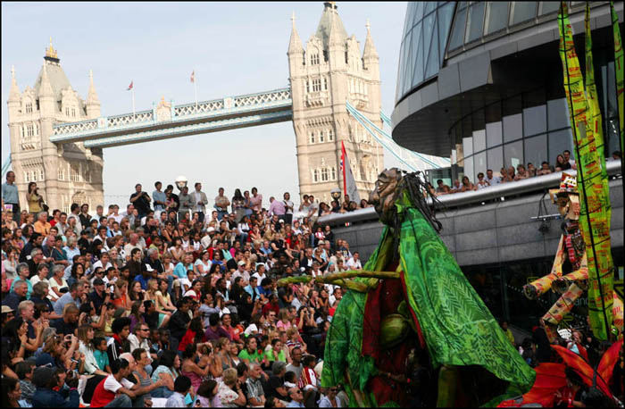
Accreditation of good sustainability practices (Green Key, NL)
Identity – heritage-led event transition from Communism to market-led economy (LT, LV)
Cost efficiencies and external funding through environmental innovation (UK, IT)
Notes:
In Holland, tourism service offer accreditation is now being adapted for sustainable and green festivals and events (Green Key)
The contribution of cultural events and festivals to sustaining place identity through the transition from communism to a market-led economy has been particularly prevalent in Lithuania and Latvia
Greening innovations that help to reduce the operating costs of events (incl. energy savings) are a major driver in the UK and Italy

Slide 15
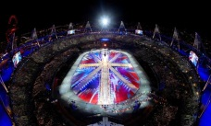
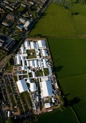
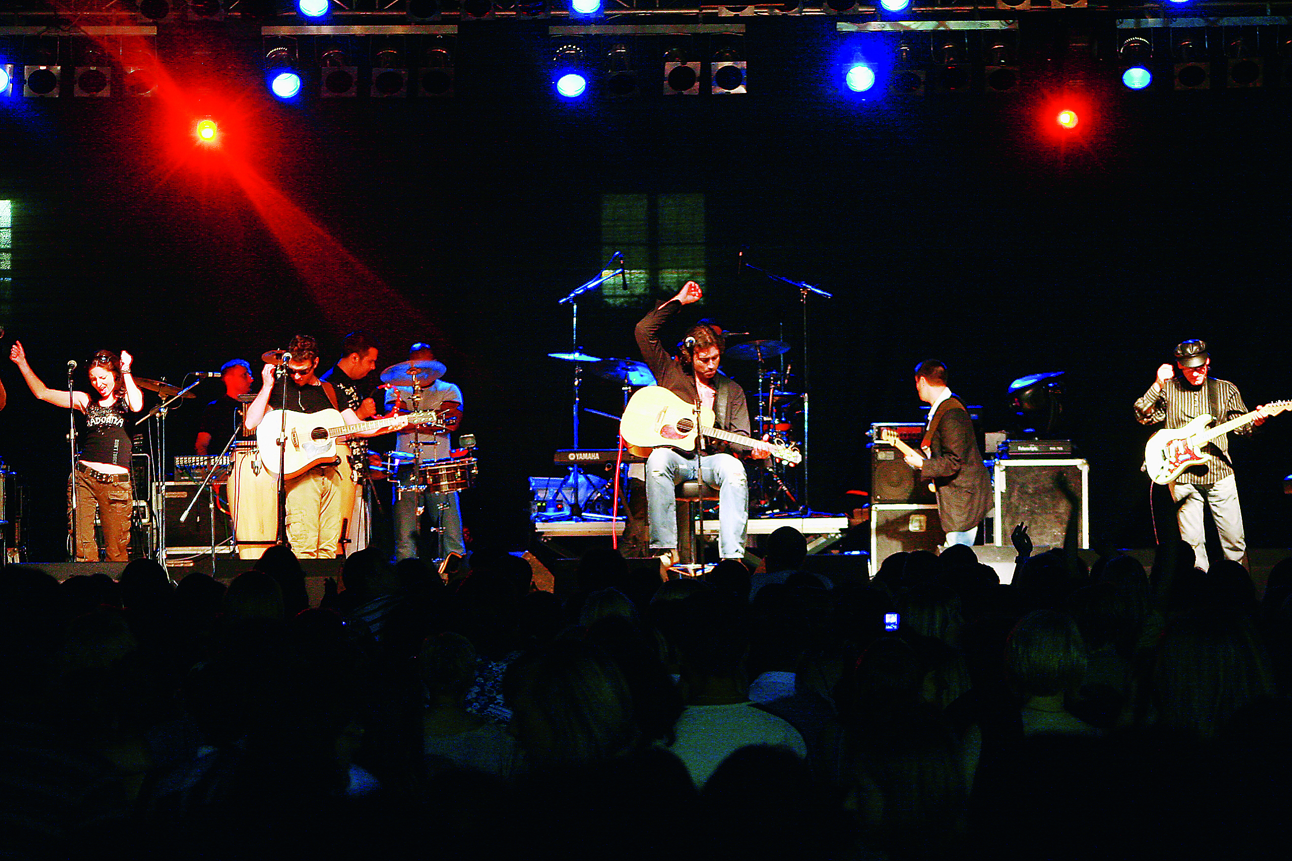
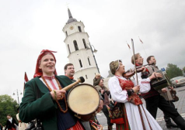
Towards an international typology of sustainable cultural events
Mega event
High ‘core’ carbon footprint
Public funding
Private funding
Low ‘core’ carbon footprint
Micro event
Coca-Stefaniak (2013), on-going research
Notes:
On-going research towards an international classification (typology) of sustainable events shows that the size of the event and its funding sources (private vs. public) are likely to play a major role in the carbon footprint that events and festivals may leave behind (by ‘core’ carbon footprint we mean environmental impacts of the event itself and not indirect impacts such as flight travel to its location by visitors)

Slide 16
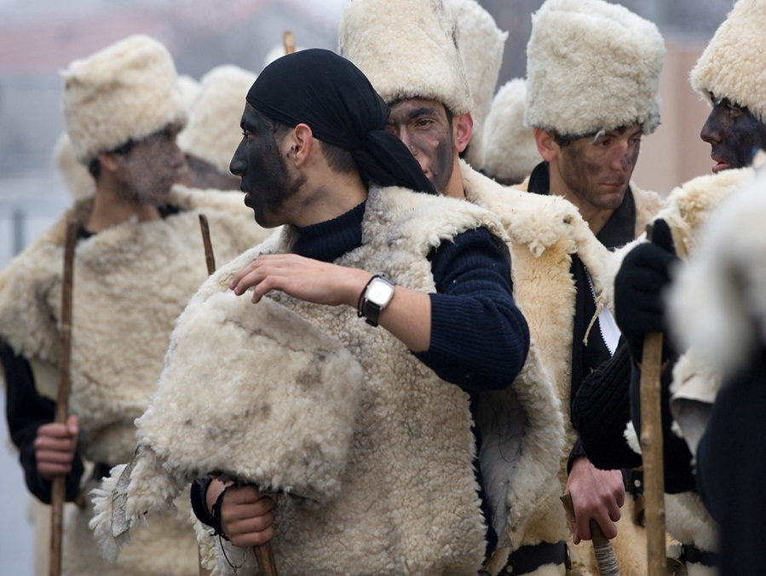
So what? …

Slide 17
Moving research forward in evaluation of sustainable events
Events as test beds for innovation in sustainable solutions (e.g. EU-wide accreditation system?)
Events as more than standard bearers (vis-a-vis strategic place branding)
CSR research v. event environmental impact research
Marketing ‘authenticity’ or commoditification of visitor experience?
Experiential marketing strategies?
Government policy impact (e.g. Welsh Assembly Sustainable Development Bill)
Notes:
The points outlined above show the potential of events and festivals research to contribute to cross-disciplinary research agendas in sociology, government policy, place marketing and branding, CSR, city management, urban planning and regeneration, social innovation, consumer behaviour, psychology, urbanism and digital communications, to mention but a few.

Slide 18
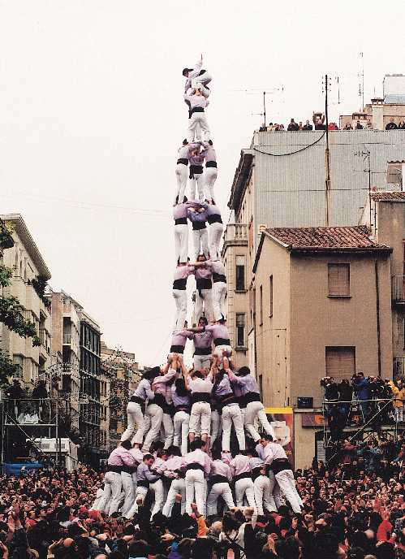
Thank you
Dr. Andres Coca-Stefaniak
j.a.coca-stefaniak@uel.ac.uk
Ian Bathgate
i.bathgate@uel.ac.uk
www.zen-project.eu

Slide 19
References
- Coca-Stefaniak J.A., Rinaldi R., Parker C. and Quin S. (2009), “Evolution of town centre and place management models: a European perspective”, Cities, 26 (2), pp. 74-80.
- Coca-Stefaniak J.A. (2012), Evolution of international town centre management models, Doctoral thesis, Middlesex University.
- Chalip L (2004), Beyond impact: A general model for host community event leverage. In: Ritchie B and Adair D (eds.), Sport Tourism: Interrelationships, Impacts and Issues, Clevedon: Channel View Publications, pp. 226-252.
- DCMS (2012), London 2012 Olympic and Paralympic Games Impacts and Legacy Evaluation Framework Final Report, Department for Culture, Media and Sport, http://www.culture.gov.uk/images/publications/DCMS_2012_Games_Meta_evaluation_Report_1.pdf (accessed 24 August 2012)
- Faulkner B, Chalip L, Brown G, Jago L, March R and Woodside A (2003), “Monitoring the tourism impacts of the Sydney 2000 Olympics”, Event Management, 6 (4), pp. 231-246.

Slide 20
References
- Getz D (2002), “Event studies and event management: On becoming and academic discipline”, Journal of Hospitality and Tourism Management, 9 (1), pp. 12-23.
- Innes J E and Boother D E (2000), “Indicators for sustainable communities: A strategy building on complexity theory and distributed intelligence”, Planning Theory & Practice, 1 (2), pp. 173-186.
- Mega V and Pedersen J (1998), Urban sustainability indicators, European Foundation for the Improvement of Living and Working Conditions, http://eurofound.europa.eu/pubdocs/1998/07/en/1/ef9807en.pdf (accessed 22 August 2012)
- Moore T (2013), Audience attitudes on the environmental impact of events CM&SS/AGF, http://www.agreenerfestival.com/wp-content/uploads/pdfs/Bucks-AGF_AUDIENCE_RESEARCH_2012.pdf (accessed 10 May, 2013).
- O’Brien D (2006), Event business leveraging: The Sydney 2000 Olympic Games, Annals of Tourism Research, 33 (1), pp. 240-261.

Slide 21
References
- Ritchie J R B (2000), “Turning 16 days into 16 years through Olympic Legacies”, Event Management, 6, pp. 155-165.
- Richards G and Wilson J (2004), “The impact of cultural events on city image: Rotterdam, Cultural Capital of Europe 2001”, Urban Studies, Vol. 41, No. 10, pp. 1931-1951.
- Wood E. (2009), “An impact evaluation framework: local government community festivals”, Event Management, Vol. 12, No. 3/4, pp. 171-185.

