Slide 1
Consulting young people on research: an example from a review of school effects on health
Farah Jamal and Angela Harden

Slide 2
Background
Patient and public involvement in research
political and ethical imperatives
pursuit of ‘better’ research
patient and public demand
New and not so new concept
Many examples from health research
Few involve young people or systematic reviews

Slide 3
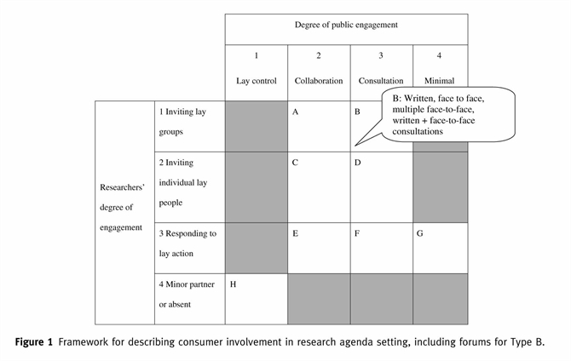
Oliver et al. (2008) A multidimensional conceptual framework for analysing public involvement in health services research. Health Expectations, Mar2008, Vol. 11 Issue 1, p72-84.

Slide 4
Collaborative project led by:
University of Oxford
IHHD UEL
Other collaborators
LSHTM
University of Liverpool
Cardiff University
Institute of Education
University of Bristol

Slide 5
Review Questions
1. What theories are used to explain school-level influences on health?
2. What are the effects of school environment interventions on student health?
3. How feasible and acceptable are school environment interventions?
4. What are the effects on health of school-level factors? (e.g. school organisation, discipline)
5. Through what processes might these school-level influences occur?
Notes:
What are the effects of school environment interventions (interventions aiming to promote health by
modifying how schools are organised and managed; or how they teach, provide pastoral care to and
discipline students; and/or the school physical environment) that do not include health education or health
services as intervention components and which are evaluated using prospective experimental and
quasi-experimental designs, compared with standard school practices, on student health [physical and
emotional/mental health and well-being; intermediate health measures such as health behaviours, body
mass index (BMI) and teenage pregnancy; and health promotion outcomes such as health-related knowledge
and attitudes] and health inequalities among school staff and students aged 4–18 years? What are their
direct and indirect costs?

Slide 7
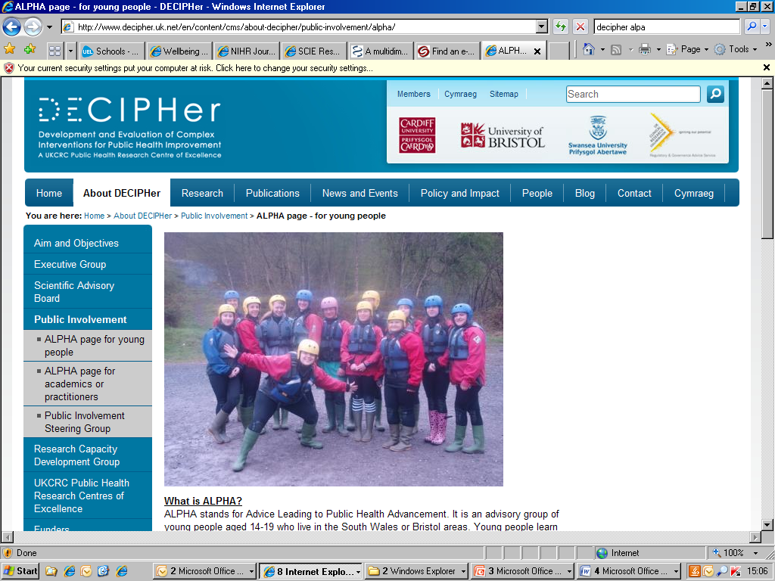
Who did we consult?
ALPHA group (Advice Leading to Public Health Advancement).
Young people aged 14 - 19 years from across South Wales
Young people have undergone training
Sessions are supported by qualified youth workers.
Notes:
ALPHA group (Advice Leading to Public Health Advancement).
Young people aged 14 - 19 years from across South Wales meet monthly and sessions
attract on average 12 members.
• Young people have undergone training
including sessions on public health, the
research cycle, ethics procedures and
reviewing materials as part of membership.
• Sessions are supported by qualified youth
workers.

Slide 8
How did we consult?
Face-to-face discussions
Online consultations
Group
exercise
consultation
Project inception
Mapping stage
SYSTEMATIC
REVIEW
Understanding the problem /
Developing research aim
Prioritising health topics /
Focusing on the review
OUTCOME

Slide 9
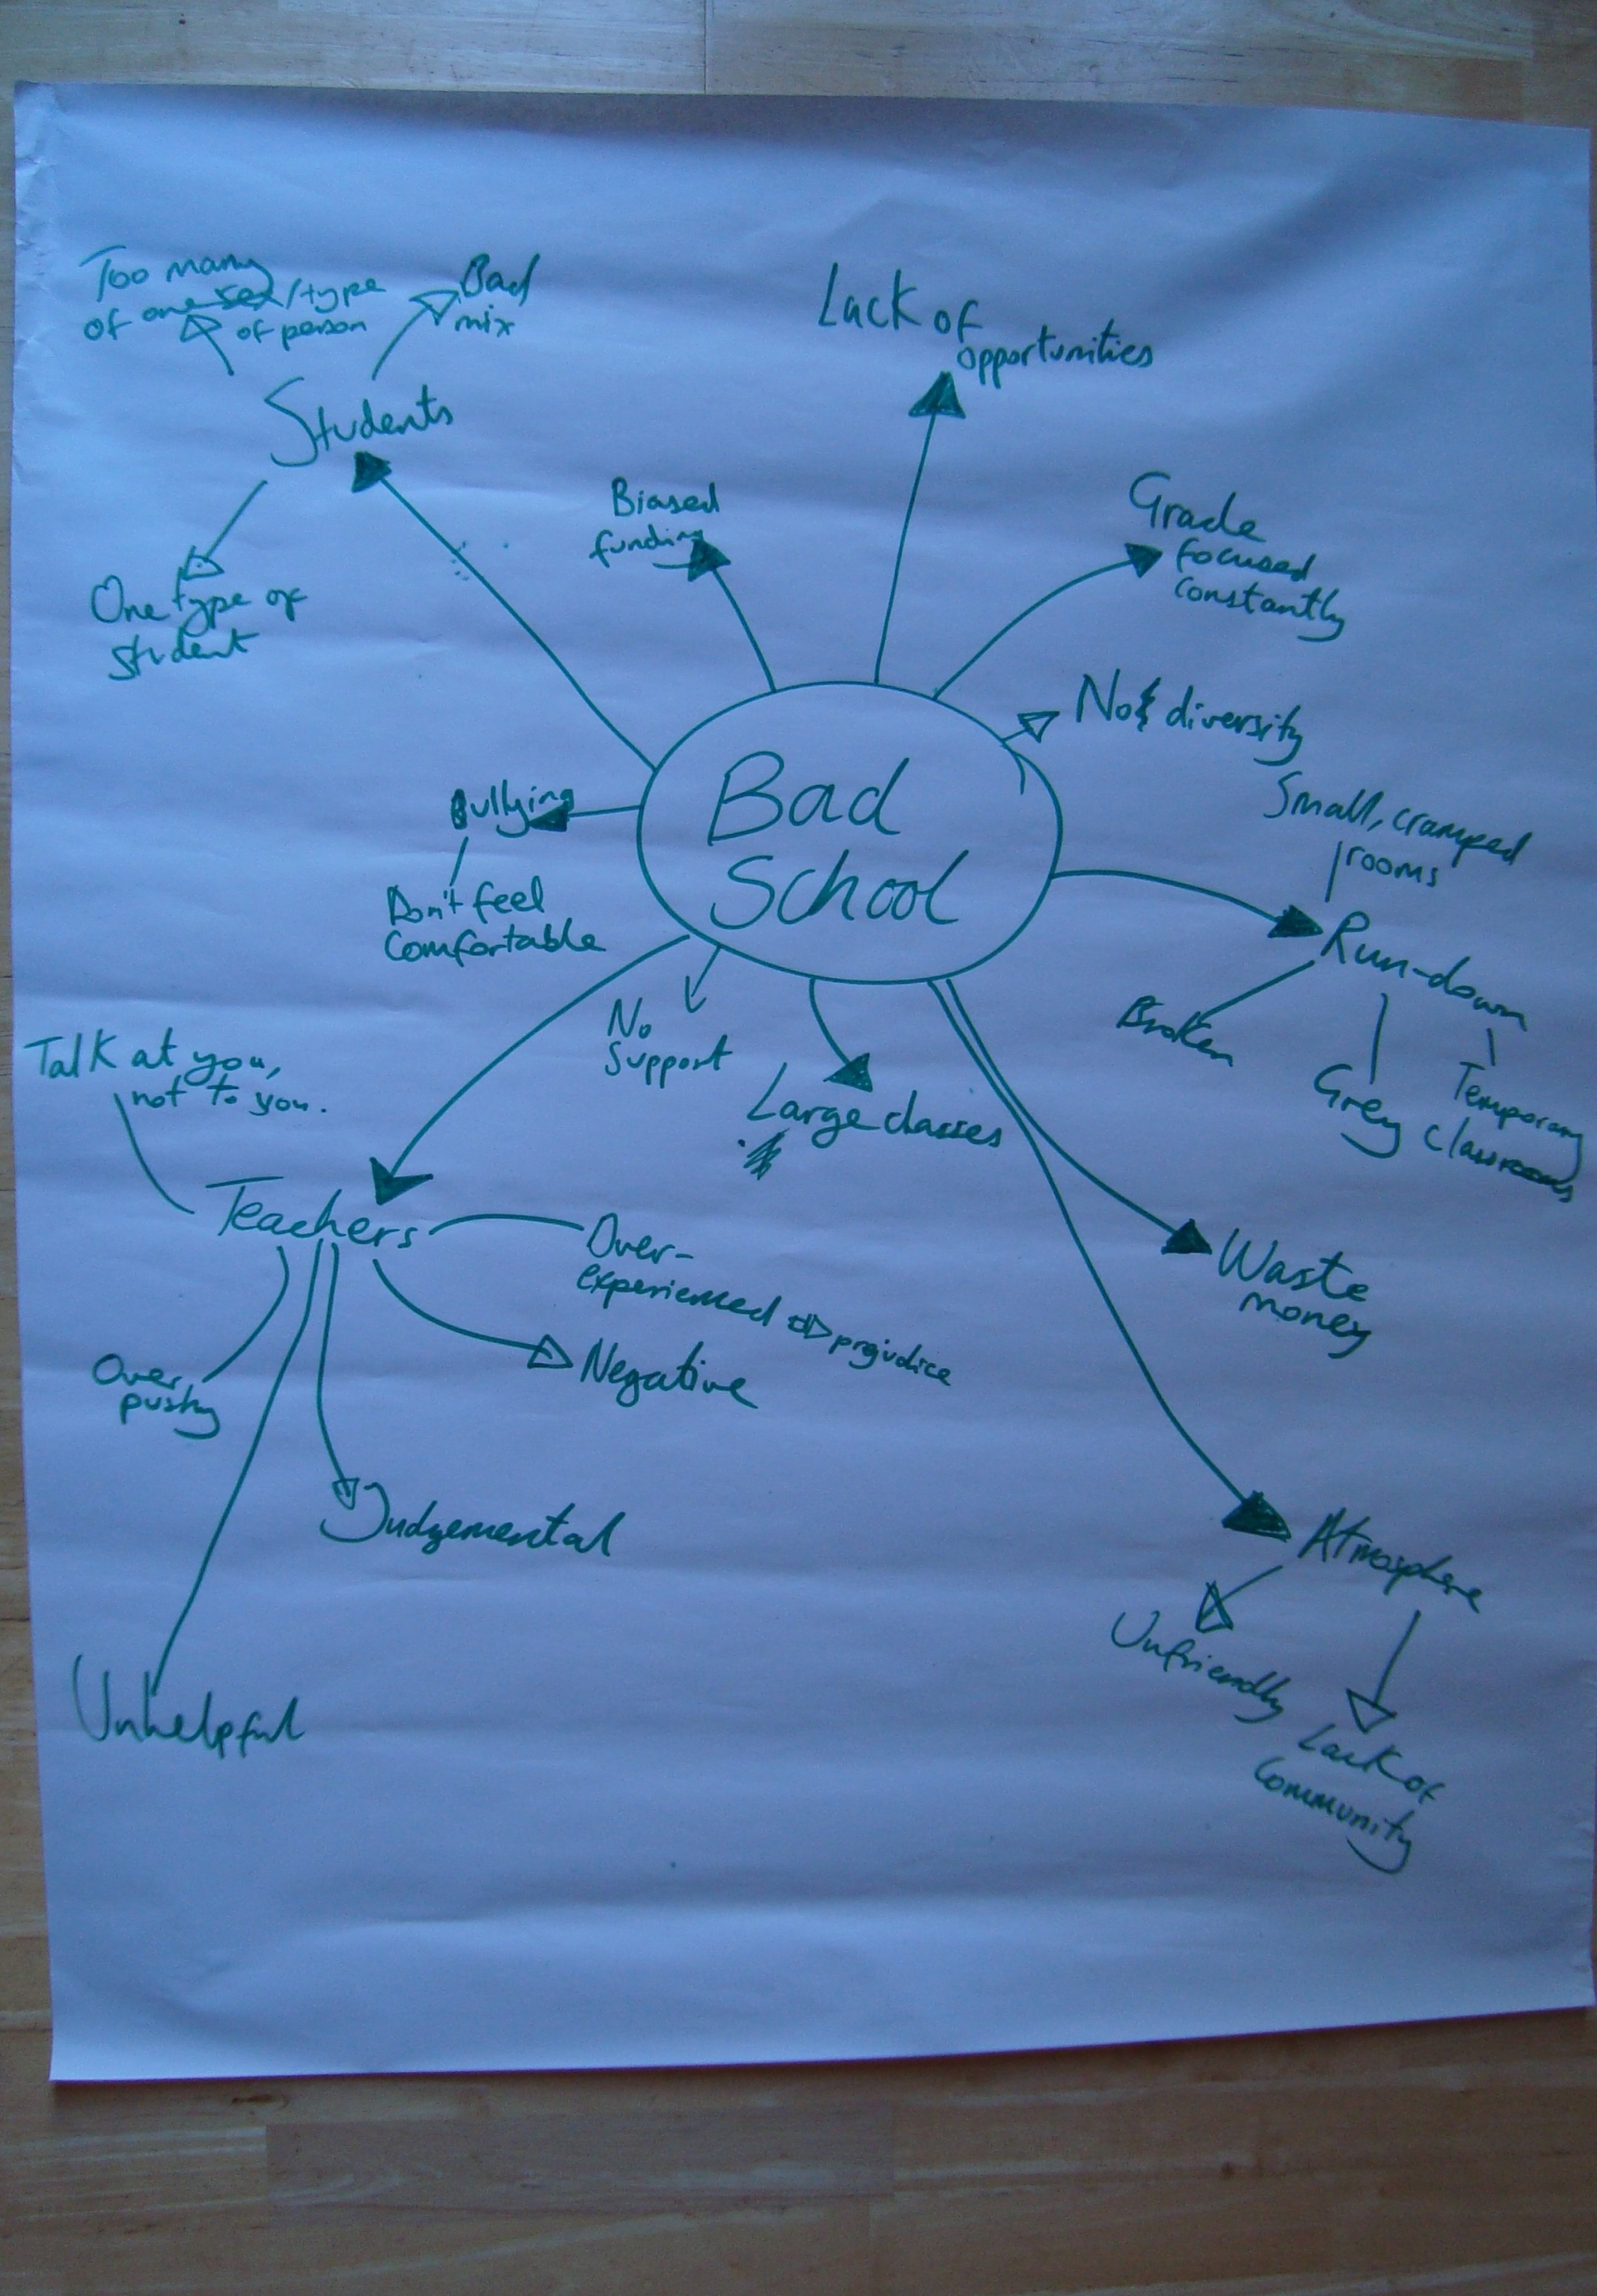
Consultation at project inception
What does health and well-being mean to you?
How do schools affect your health and well being?
What can schools do to improve your health and well being?
Notes:
What does health and wellbeing mean to you?
Young people told us that being healthy and well meant feeling safe and secure, having personal confidence, feeling self-assured and having the support of friends and family.
How do schools affect your health and wellbeing?
Class size (e.g. large classes mean less personal attention although some thought
small classes could be stifling).
Staff (e.g. having to spend time with teachers in a bad mood).
Social class (e.g. students from poorer background may feel or be made to feel out
of place).
School meals (e.g. healthy food more expensive).
Hygiene (e.g. disgusting toilets).
Choice (e.g. having a say in the running of schools).
Socialising (e.g. making friends, meeting people from different backgrounds).
Learning (e.g. making you smarter, opening your mind).
Top priorities
We concluded by asking the group what they thought were the most important things a school could do to improve student wellbeing:
Positive attitude in teachers and good relationships between staff and students.
Focus less on league tables and more on ‘learning for learning’s sake’.
Smaller class sizes.
Increase opportunities in schools to allow students to focus on what they’re
interested in or good at.
Increased social support for students so that they can focus on learning.

Slide 10
Consultation at project inception
What does health and well-being mean to you?
How do schools affect your health and well being?
What can schools do to improve your health and well being?
Notes:
What does health and wellbeing mean to you?
Young people told us that being healthy and well meant feeling safe and secure, having personal confidence, feeling self-assured and having the support of friends and family.
How do schools affect your health and wellbeing?
Class size (e.g. large classes mean less personal attention although some thought
small classes could be stifling).
Staff (e.g. having to spend time with teachers in a bad mood).
Social class (e.g. students from poorer background may feel or be made to feel out
of place).
School meals (e.g. healthy food more expensive).
Hygiene (e.g. disgusting toilets).
Choice (e.g. having a say in the running of schools).
Socialising (e.g. making friends, meeting people from different backgrounds).
Learning (e.g. making you smarter, opening your mind).
Top priorities
We concluded by asking the group what they thought were the most important things a school could do to improve student wellbeing:
Positive attitude in teachers and good relationships between staff and students.
Focus less on league tables and more on ‘learning for learning’s sake’.
Smaller class sizes.
Increase opportunities in schools to allow students to focus on what they’re
interested in or good at.
Increased social support for students so that they can focus on learning.

Slide 11
Consultation at mapping
Consensus development process
List of topics/outcomes identified during mapping discussed
Young people added additional items: depression, appearance, ‘over-achieving’, relationships
Relationships were identified as the most important (with teachers particularly)
Anxiety and general mental-health was ranked second and also considered to be very important to the group.
Notes:
depression, physical appearance;
over-achieving and ‘relationships
Anxiety and general mental-health was ranked second and also considered to be very important to the group.

Slide 12
Impact on review process and findings
Fed into decision to focus on the relationship between a school’s ‘core business’ and health.
Provided a broader context within which to interpret the review findings.
Able to evaluate the research literature against priorities of young people.

Slide 13
Reflections
Face to face consultation worked best, on-line phase underdeveloped
Established group with research knowledge and youth worker support has many advantages
BUT – may have missed local East London perspectives
Large, complex review – more limited impact of young people’s consultations?

Slide 14
Thank you!
The full report can be found at
http://www.journalslibrary.nihr.ac.uk/phr/volume-1/issue-1
The views and opinions expressed therein are those of the authors and do not necessarily reflect those of the NIHR PHR programme or the Department of Health.

