Slide 1
Vaping profiles and preferences: an online survey of electronic cigarette users
Dawkins, L., Turner, J. Roberts, A. & Soar, K.
Drugs & Addictive Behaviours Research Group, School of Psychology, UEL
http://www.uel.ac.uk/psychology/research/drugs/

Slide 2
Conflict of Interest
Lynne Dawkins has undertaken research for e-cigarette companies, received products for research purposes and funding for speaking at research conferences
The other authors have no conflict of interest
No funding was received for this study

Slide 3
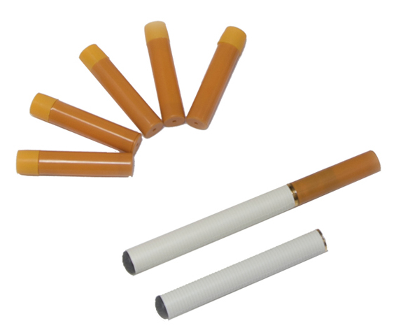
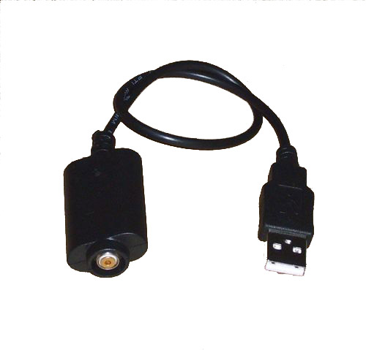
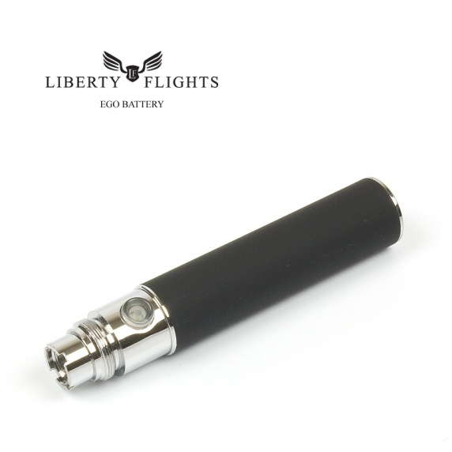
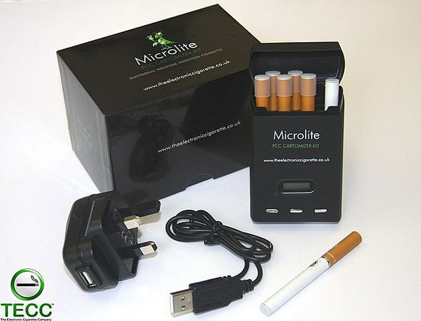
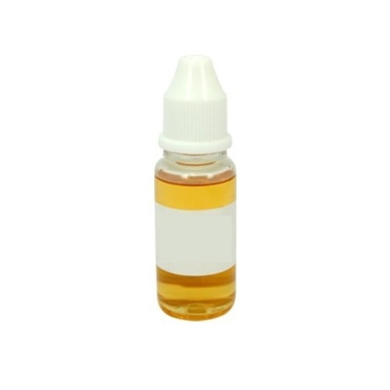
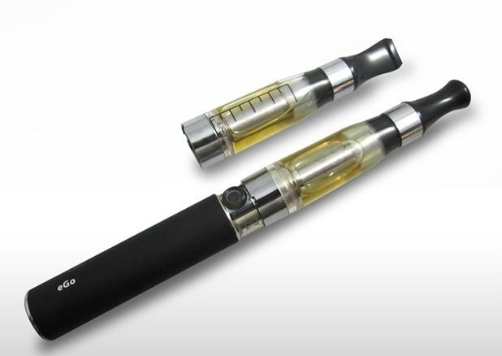
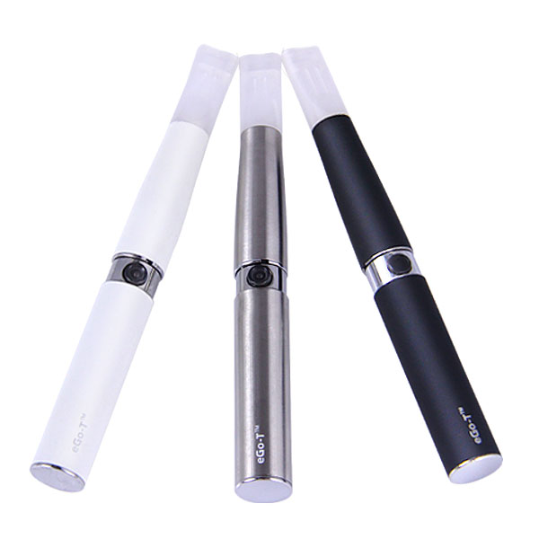
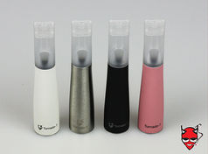
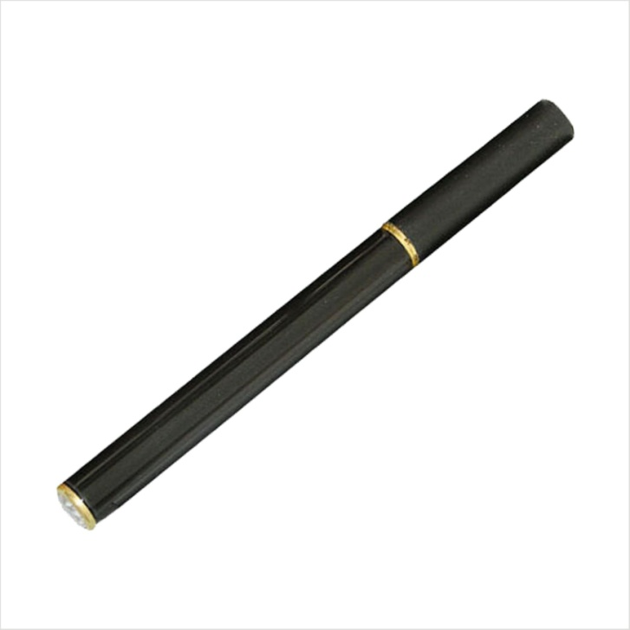
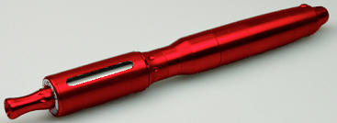
E-cigarettes: what are they?

Slide 4
Previous survey data (Etter & Bullen, 2011)
N = 3587; 62% US
62% male; 70% ex-smoker
93% agreed that the e-cigarette (EC) had helped them to quit or reduce their smoking
Participants used e-cig to deal with tobacco craving (79%), withdrawal symptoms (67%) or to quit smoking/avoid relapsing (77%)

Slide 5


Current Aims:
To characterise EC users, use and effects in a sample of Totally Wicked (TW) and The Electronic Cigarette Company (TECC) users
  Characteristics of users
  Nature of use
  Positive and negative effects

Slide 6
Method
Data collected between Sept. 2011 & May 2012
Q’nnaire hosted on UEL server; links from TECC & TW.
15-20 min questionnaire: 6 sections – demographics, tobacco smoking info., use of EC, effects of EC, side effects of EC., other comments.

Slide 7
Results: Survey Respondents
1376 initial responses
27 removed
1349 responses
2 ‘never-smokers’ removed
Final sample: 1347

Slide 8
Results: Participant information
 | N | Mean (SD)
Age (years) | 1302 | 43 (12)
FTCD | 1317 | 6 (2.41)
 | N | %
Smoking status:
Ex-smoker | 1123 | 83
Current smoker | 218 | 16
Never smoker | 4 | 0.3
Gender | 1287
Male | 897 | 70
Ethnicity | 1272
White | 1225 | 96
Education | 1274
Degree or above | 560 | 44
Country | 856
Europe | 623 | 73
USA | 211 | 16

Slide 9
EC patterns of use
 | N | Mean (SD)
Duration of use (days) | 1334 | 316 (334)
Max. daily use (ml) | 1197 | 3.36 (3.53)
Max. daily use (puffs) | 983 | 236 (339)
 | N | %
Product type
Tank (any) | 678 (out of 974) | 72
Tornado EGo-C | 301 | 23
Tornado Tank | 197 | 15
Custom made | 113 | 9
Strengths used
18mg/ml | 663 | 49
11mg/ml | 447 | 33
mix own/combine strengths | 286 | 21
0 mg/ml only | 14 | 1
Preferred flavour
Tobacco | 664 | 53
Fruit | 421 | 33
Mint/menthol | 357 | 28

Slide 10
Reasons for Use / Effects on smoking
 | N | %
Why start using EC?ª
complete alternative to smoking | 1027 | 76
partial alternative to smoking | 257 | 19
Other | 730 | 65
Since using EC^{b}:
not smoked for several weeks | 221 | 17
not smoked for several months | 760 | 57
Since EC use, tobacco craving has^{b}:
Decreased | 1208 | 91
Attempted to cut down EC use | 392 out of 1330 | 30
Success at cutting down? | 385
Successful | 231 | 60
Unsuccessful | 154 | 40
ª Respondents could indicate more than one option; ^{b} Forced choice option

Slide 11
Effects of the EC
 | N | Not at all (%) | Very much so (%)
The EC has helped me to stop smoking | 1333 | 1.5 | 89.4
My breathing has improved since using the EC | 1327 | 3.5 | 72.4
EC use is as satisfying as tobacco smoking | 1335 | 1.2 | 68.0
I crave ECs as much as I do/did tobacco cigarettes | 1322 | 13.3 | 18.4
The EC allows me to use nicotine more | 1327 | 47.6 | 11.1
I frequently use the EC in places where smoking is banned | 1326 | 16 | 35.9

Slide 12
Negative effects of the EC (%)
 | Not at all | Slightly | Quite a lot | All the time
Mouth irritation | 77 | 21 | 1 | 0.5
Throat irritation | 63 | 33 | 3 | 0.5
Feeling sick | 91 | 8 | 0.6 | 0.3
Flatulence/Bloating | 86 | 11 | 2 | 1
Heartburn | 86 | 13 | 1 | 0.4
Feeling dizzy | 84 | 15 | 1 | 0.2
Headache | 84 | 15 | 1 | 0.2

Slide 13
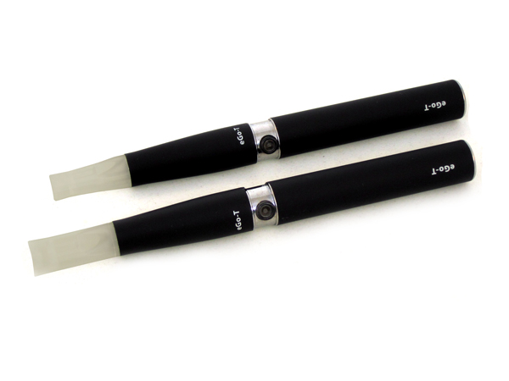
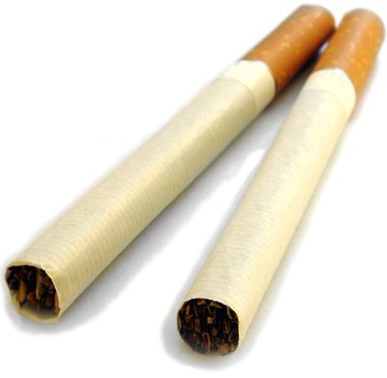
Ex vs. current smokers
Ex-smokers reported:
  Using a tank or custom-made device
  Greater craving reduction with the EC
  Greater benefit to breathing
  Stronger ‘hit’ from the EC
  Less throat irritation
No differences in liquid strength or flavour
(All smoker group differences significant at p < 0.01)

Slide 14
Gender differences
(All gender differences significant at p < 0.01)
Males
Predominantly male sample (70%)
More likely to use screwdriver or Tank
Favourite flavour: tobacco
Females
Preferred super/mini kits
Favourite flavour: chocolate/sweet
more likely to report that they ‘liked the taste’ and liked the EC because it ‘looks and feels like a cigarette’
No gender effects for: time to vape, duration of use, amount used, strength, effects on tobacco consumption, craving or attempt to cut down

Slide 15
Summary
Typical EC user is male, white, educated, early 40s and...
... wants to stop smoking.
¾ reported not smoking at all for at least a few weeks
ECs were satisfying to use, associated with improved cough & breathing and...
and very few adverse effects
Limitations

Slide 16
Summary cont. & future directions
Ex-smokers’ product choice – are Tanks better?
Females prefer ECs resembling cigarettes
  Is visual appearance important?
Long mean duration of use ~ 10 months
Addictive potential? Mixed findings
Long term effects (e.g. Lung function)?
Appeal to non-smokers?

Slide 17
Acknowledgements
Thanks to all the participants for the wealth of information and plethora of further comments!
TECC & TW for providing links from their web pages
TW for funding my attendance at UKNSCC

